Slide 1
LESSON -6
THE GREAT UPRISING

Slide 2
Imagine that someone from Lord Dahousie family was to meet a descendent of Rani Lakshmi Bai of Jhansi.
What kind of conversation do you think would tale place between them?
Write a news paper report and give a suitable headline.

Slide 3
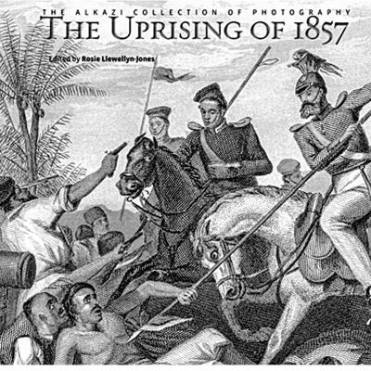
REVOLT OF 1857
CAUSES OF THE UPRISING:
ECONOMIC CAUSES
POLITICAL CAUSES
SOCIAL CAUSES
RELIGIUOS CAUSES
MILITARY CAUSES
IMMEDIATE CAUSE
2/7/2020

Slide 4
ECONOMIC CAUSES
SUFFERING OF THE PEASANTS
UNFAIR COMPETITION TO THE ARTISANS AND CRAFTSMEN
DISPLACEMENT OF OLD RULING CLASSES

Slide 5
POLITICAL CAUSES
Rulers who accepted subsidiary alliance lost their independence
Strict enforcement of Doctrine of Lapse
Betrayal and back stabbing by the British

Slide 6
QUESTIONS RELATED TO ABOVE SLIDES
Explain the economic causes for the Great revolt.
Brief the political causes for the uprising of the revolt of 1857.

Slide 7
SOCIAL CAUSES
BANNING OF SATI & LEGALISING WIDOW REMARRIAGE
WOMEN TOOK UP WESTERN EDUCATION
BRITISH FELT SUSPICIOUS
SOCIAL DISCRIMINATION
BRITISH SHOWED RACIAL SUPERIORITY
CONDITIONS ON TRAVEL ,EDUCATION & PROMOTION FOR INDIANS
EDUCATED INDIANS TURNED AGAINST BRITISH

Slide 8
RELIGIOUS CAUSE

Slide 9
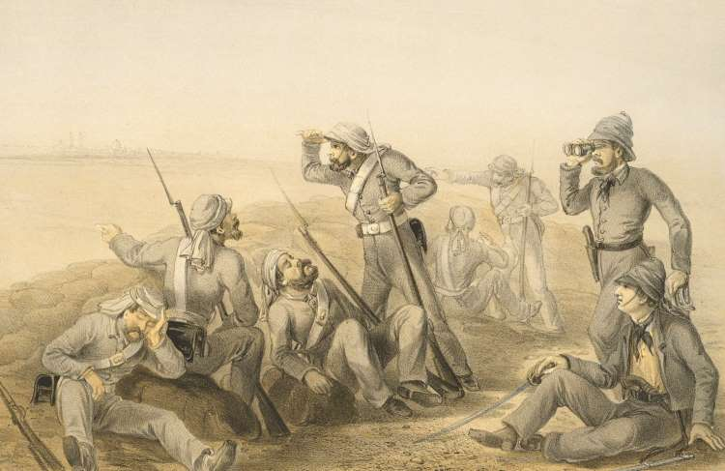
MILITARY CAUSES
SEPOYS WERE PAID LES.S
TREATED AS INFERIOR CREATURES.
NO HIGHER POSTS FOR INDIAN SOLDIERS.
NO WEARING CASTE OR RELIGIOUS MARKS.
PASSING OF ACT TO TRAVEL OVERSEAS.
BHATTA WAS STOPPED.
2/7/2020

Slide 10
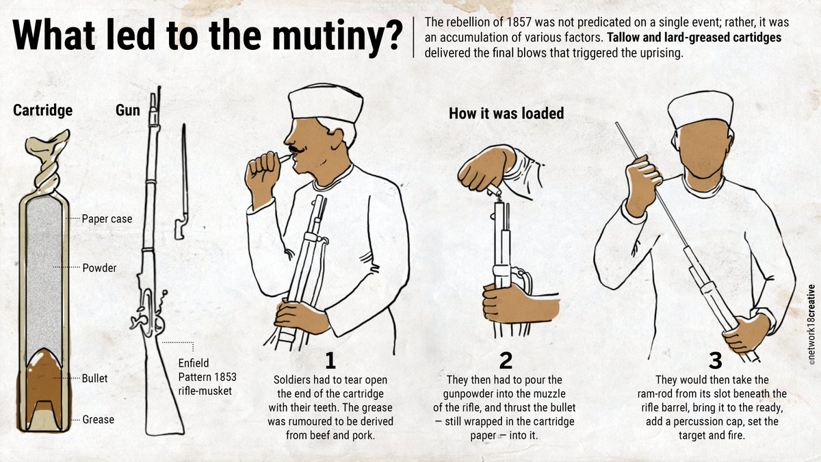
IMMEDIATE CAUSE

Slide 11
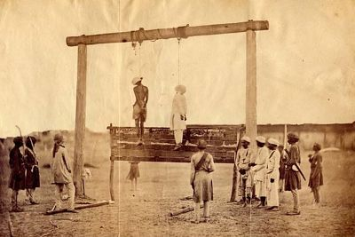
BEGINNING OF THE UPRISING
ON 29 MARCH 1857, HE FIRED AT THE BRITISH COMMANDER
HE WAS HANGED ON APRIL 8, 1857
2/7/2020

Slide 12
LEADERS OF THE GREAT REVOLT
2/7/2020

Slide 13
QUESTIONS RELATED TO ABOVE SLIDES:
Explain the immediate cause of 1857 revolt.
Describe in brief the social causes of the 1857 revolt.

Slide 14
Fall of uprising:
1)No support, No cooperation .
2) No proper organisation.
3) Lack of efficient leadership.
4) Short of weapons and finance.

Slide 15
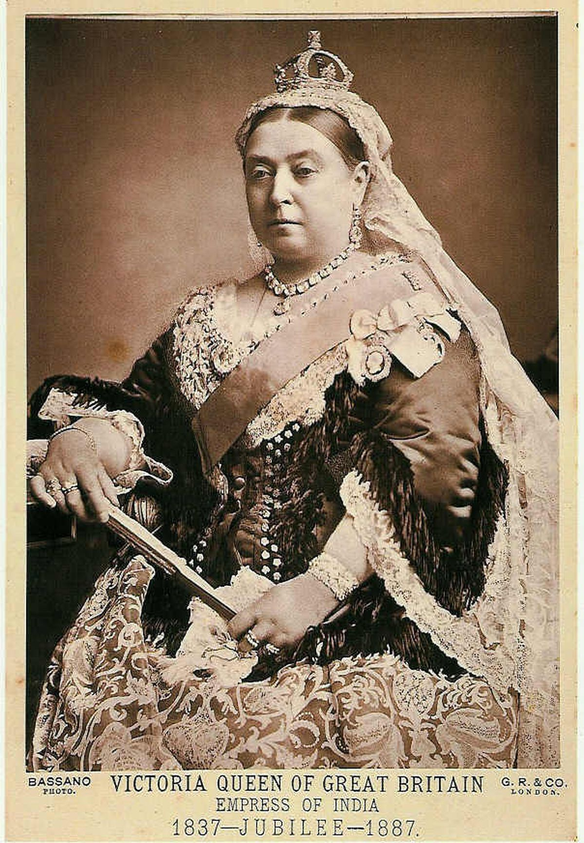
AFTER UPRISING
Act of 1858.
Secretary of state and Indian Council
Governor general and viceroy
Withdrawal of doctrine of Lapse.
Non interference in social and religious beliefs.
Divide and rule.
Martial and non martial races.
2/7/2020

Slide 16
REFERENCES
rsgr.in/sh0165
Rsgr.in/sh0167
https://www.youtube.com/watch?v=PW38U5cb1H8
Thank you

